Slide 1
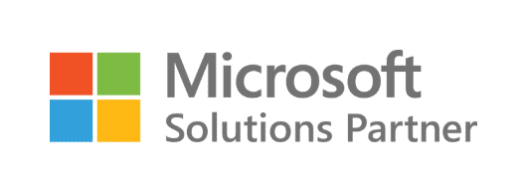
Building adaptive intelligent Enterprises
About Asper
Asper.ai – Unlock revenue growth for customers through a purpose-built AI to enable interconnected decisions.
WHAT WE OFFER
Asper helps unlock Revenue Growth Potential up to 8-10% at the intersection of Demand and Supply.
Our first product, Dynamic Demand AI (DDAI), helps achieve 5-15% improvement in current accuracy over operational forecast unlocking a high potential revenue growth
We enable 3x faster realization of potential business impact through accelerated proof of value in 3-4 weeks.
We offer a completely cloud based SAAS solution that easily integrates and is completely managed by Asper to provide end to end automated No Touch Forecast
Our AI/ML solution along with WebApp addresses 8 major pain points of today’s demand planner and has been designed after interviewing 100+ Demand Planners across CPG orgs.
Our deep domain expertise allows us to curate 100+ leading indicators of demand to help true agile planning for the Enterprise.
Leading Snacking, Beverage, Meal Preparation Customer
$4.5B
Revenue
11,000
SKUs
32
Categories
$39.5M Value Unlock
$150K
Less Infra Cost
25%
Productivity Gains
10+ppt forecast accuracy improvement; 60% portfolio no-touch forecast

Slide 2
Why Microsoft Azure?
Be future-ready
Continuous innovation from Microsoft supports your development today, and your product visions for tomorrow. With 1,000+ new capabilities in the past year, you can build on the latest advancements in AI, blockchain, Kubernetes, containers, and databases to keep you ahead of the curve.
Our enterprise grade analytics solution outperforms the competition, costs less, and is fully compatible with your existing development, BI, and data-science tools.
Operate hybrid seamlessly
On-premises, in the cloud, and at the edge—we’ll meet you where you are. Integrate and manage your environments with tools and services designed for hybrid cloud.
Enhance security, simplify access, and set smart policies across your different environments with a single-identity platform trusted by 90% of enterprises globally.
Build on your terms
You have choices. With a commitment to open source and support for all languages and frameworks, build and deploy how you want to. Take advantage of the full-featured, integrated development environments with built-in support Visual Studio and Visual Studio Code, the most popular IDEs trusted by 15M+ developers.
We embrace open source, drive innovation through collaboration, and contribute back to the community.
Trust your cloud
Get security from the ground up, backed by a team of experts, and proactive compliance trusted by enterprises, governments, and startups.
With a $1B+ investment in security R&D and 3,500 cybersecurity experts, security is foundational for Azure.
Microsoft Azure is an ever-expanding set of cloud computing services to help your organization meet its business challenges. With Azure, your business or organization has the freedom to build, manage, and deploy applications on a massive, global network using your preferred tools and frameworks.
www.MicrosoftAzure.com
Asper.ai | https://asper.ai/| anuj.kaushik@asper.ai | +1 2012734455

